Slide 1
Natural Language Generation
Natural Language Processing
(based on revision of Abigail See and Antoine Bosselut Lectures)

Slide 2
Announcement
TA announcements (if any)...

Slide 3
Suggested Readings
The Curious Case of Neural Text Degeneration
Get To The Point: Summarization with Pointer-Generator Networks
Hierarchical Neural Story Generation
How NOT To Evaluate Your Dialogue System

Slide 4
Intro

Slide 5
Natural Language Generation
Natural Language Generation (NLG) refers to any setting in which we generate (i.e., write) new text.
NLG is a subcomponent of
Neural Machine Translation (NMT)
(Abstractive) Summarization
Dialogue (chit-chat and task-based)
Creative writing: storytelling, poetry-generation
Free Question Answering (i.e., answer is generated, not extracted from text or knowledge base)
Image captioning
...

Slide 6
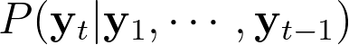
Language Modeling
Language Modeling (LM): the task of predicting the next word, given the words so far
A system that produces this probability distribution is called a LM
If that system is an RNN, it’s called an RNN-LM

Slide 7
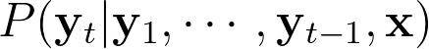
Conditional Language Modeling
Conditional Language Modeling (LM): the task of predicting the next word, given the words so far as well as some input
Examples of conditional language modeling tasks:
Machine Translation (x = source sentence, y = target sentence)
Summarization (x = input text, y = summarized text)
Dialogue (x = dialogue history, y = next utterance)
...

Slide 8
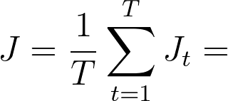
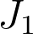

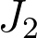
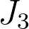
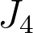
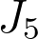
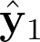
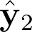
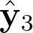
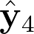
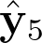
Training a (conditional) RNN-LM
=negative log prob of “deep”
=negative log prob of “fun”
=negative log prob of “<END>”
“Teacher forcing”
Encoder RNN
Decoder RNN
deep
learning
macht
Spaß
<START>
deep
learning
is
fun
source sentence (from corpus)
target sentence (from corpus)

Slide 9
Decoding algorithms
How do we use the RNN-LM to generate text?
A decoding algorithm is an algorithm we use to generate text from our LM
We’ve learned about two decoding algorithms:
Greedy decoding
Take argmax (i.e., simply take the word with highest probability)
Then feed that as the input on the next step
Keep going until you produce <END> or reach some length
Usually bad because of lack of backtracking
Beam search
Keep track of the k most probable partial sequences
Stop when specified number of hypotheses is reached or when some length is reached
Choose the hypothesis with the highest probability (factoring in some adjustment for length)

Slide 10
What’s the effect of beam size (k) ?
Small k has similar problems to greedy decoding (k=1)
Ungrammatical, unnatural, nonsensical, incorrect
Larger k means you consider more hypothesis
Increasing k is more computationally expensive
Increasing k introduce other problems:
For NMT, increasing k too much decreases BLEU score (Tu et al., Koehn et al.)
Primarily because it produces too-short translations (even with score normalization!)
It can even produce empty translations (Stahlberg & Byrne 2019)
In open-ended tasks like chit-chat dialogue, large k can make output more generic (next slide)
Neural Machine Translation with Reconstruction, Tu et al, 2017 https://arxiv.org/pdf/1611.01874.pdf
Six Challenges for Neural Machine Translation, Koehn et al, 2017 https://arxiv.org/pdf/1706.03872.pd f

Slide 11
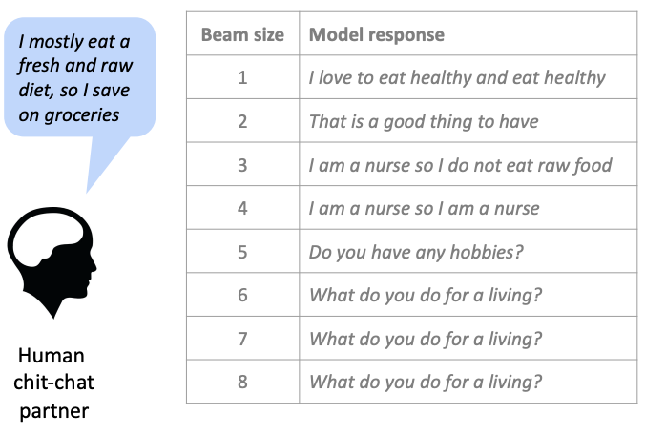
Effect of beam size in chit-chat dialogue
Low beam size:
More on-topic but nonsensical; bad English
High beam size:
Converges to safe “correct” response, but it’s generic and less relevant

Slide 12
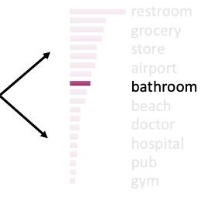
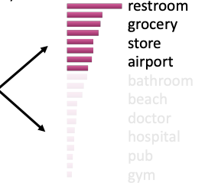
Sampling-based decoding - another method
Pure sampling
On each step t, randomly sample from the probability distribution to obtain your next word
Like greedy decoding, but sample instead of argmax
Top-k sampling
(this k is NOT related to beam search)
On each step t, randomly sample from the probability distribution, but restricted to just the top-k most probable words
Like pure sampling, but truncate the probability distribution
k = 1 is greedy search, k = V is pure sampling
Increase k to get more diverse/risky output
Decrease k to get more generic/safe output

Slide 13
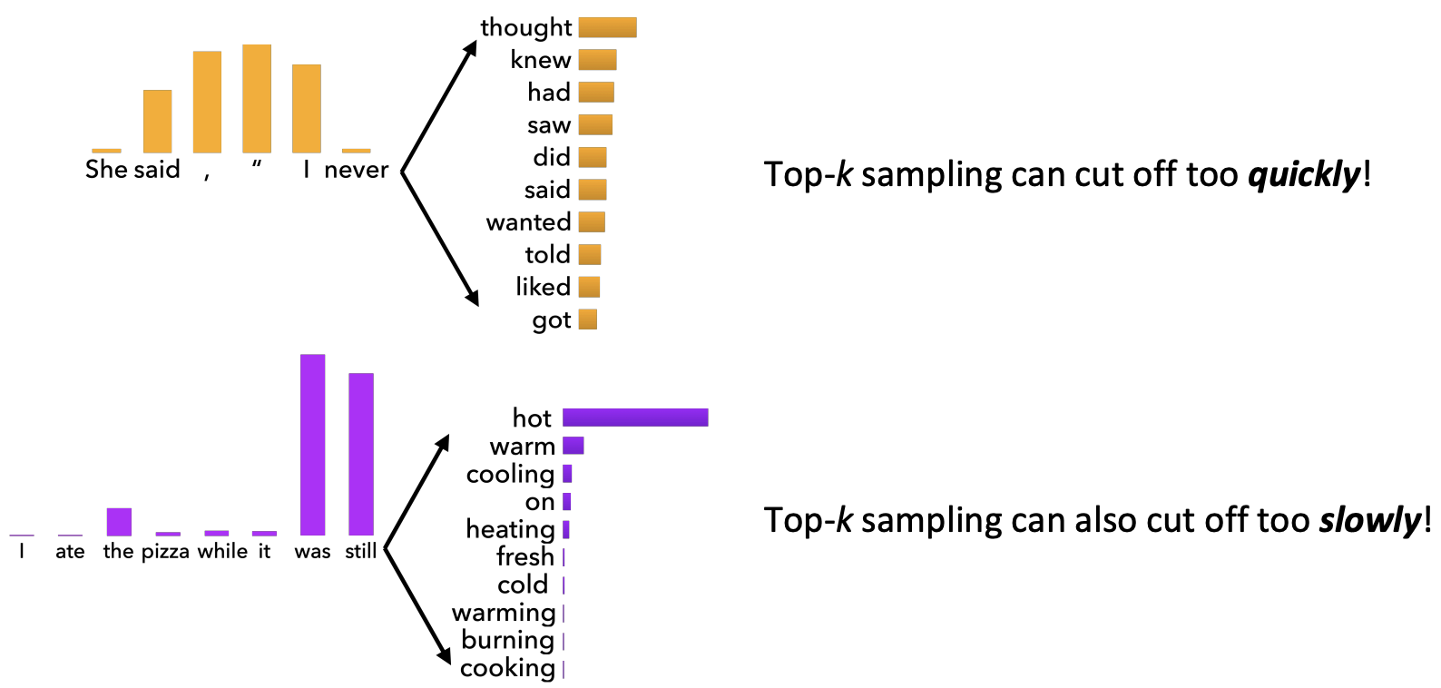
Issues with Top-k sampling

Slide 14
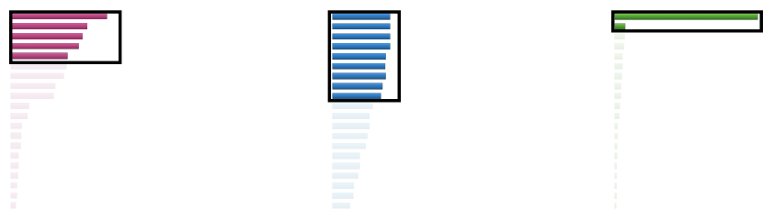
Sampling-based decoding - another method
Top-p sampling
On each step t, randomly sample from probability distribution, but restricted to just the top-p cumulative distribution mass (i.e., where mass is concentrated)
Varies k depending on the uniformity of the distribution

Slide 15
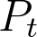
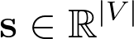
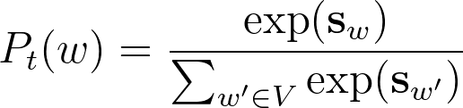
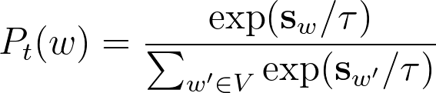
Softmax temperature - scaling randomness
Recall: On timestep t, the LM computes a prob dist by applying the softmax function to a vector of scores (this score is generated by our neurons).
We can apply a temperature hyperparameter tau [any number] to the softmax
Raise the temperature tau to make the prob dist more uniform
Thus more diverse output (prob is spread around more vocabs)
Lower the temperature to make prob dist more spiky
Thus less diverse output (probability is concentrated on top words)
Note that softmax temperature is NOT a decoding algorithm
It’s a technique you apply at test time, in conjunction with a decoding algorithm (such as beam search or sampling)

Slide 16
Summary
Greedy decoding is a simple method; gives low quality output
Beam search (especially with high beam size) searches for high probability output
Delivers better quality than greedy, but if beam size is too high, can return high probability but unsuitable output (e.g., too generic)
Sampling methods are a way to get more diversity and randomness
Good for open-ended / creative generation (poetry, stories)
Top-k / Top-p sampling allows you to control diversity
Softmax temperature is another way to control diversity
Basically a parameter to scale the confidence level of your model
It’s not a decoding algorithm! It’s a technique that can be applied alongside any decoding algorithm
Also other methods, for example, recalibrating the distributions using existing statistics of n-grams (Khandelwal et al. ICLR 2020), or re-ranking the distribution using some outside metric like perplexity or style or anything (Holtzman et al., 2018)
Teacher forcing remains the key but there is a lot of work trying to add diversity (e.g., scheduled sampling, exposure bias, or training with reinforcement learning)
A lot more work to be done! Very fun area to explore!

Slide 17
Text Summarization

Slide 18
Summarization: task definition
Task: given input text X, write a summary Y which is shorter and contains the main information of X
Summarization can be single-document or multi-document
Single-document means we write a summary Y of a single document X
Multi-document means we write a summary Y of multiple documents X₁,...,X_{n}

Slide 19
Summarization: task definition
Within single-document summarization, there are datasets with source documents of different lengths and styles:
Gigaword: first one or two sentences of a news article
LCSTS: Chinese microblogging
NYT, CNN/DailyMail: news article
Wikihow: full how-to article
XSum (Narayan et al., 2018), Newsroom (Grusky et al., 2018), etc.
…
Sentence simplification is a different but related task: Rewrite the source text in a simpler (sometimes shorter) way
Simple Wikipedia: standard Wikipedia sentence
Newsela: news article
List of summarization datasets, papers, and codebases: https://github.com/mathsyouth/awesome-text-summarization

Slide 20
Summarization: task definition
Two main strategies
Extractive summarization: select parts (typically sentences) of the original text to form a summary
Easier but restrictive (no paraphrasing)
Abstractive summarization: generate new text using natural language generation techniques
More difficult but more flexible

Slide 21
Pre-neural summarization
Pre-neural summarization systems were mostly extractive. Pipeline:
Content selection: choose some sentences to include. To select, there are many ways:
Sentence scoring functions - presence of topic words (computed from tf-idf or the like) or based on features such as position of the sentence
Graph based algorithms: document as nodes, and edges as connection between each sentence pair; edge weight is proportional to sentence similarity; then use graph algorithms to identify sentences that are central to the graph
Information ordering: choose an ordering of those sentences
Sentence realization: edit the sequence of sentences (e.g., simplify, remove parts, fix continuity issues)

Slide 22
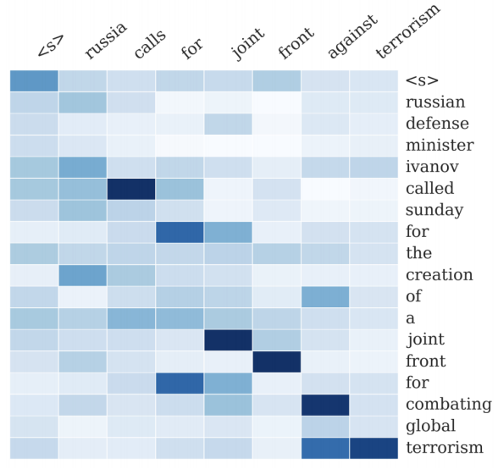
Neural summarization - seq2seq attention
2015: Rush et al. publish the first seq2seq summarization paper
Works on single-document abstractive summarization and treat it as a translation task!
Thus we can apply standard seq2seq + attention NMT methods
A Neural Attention Model for Abstractive Sentence Summarization, Rush et al, 2015 https://arxiv.org/pdf/1509.00685.pdf

Slide 23
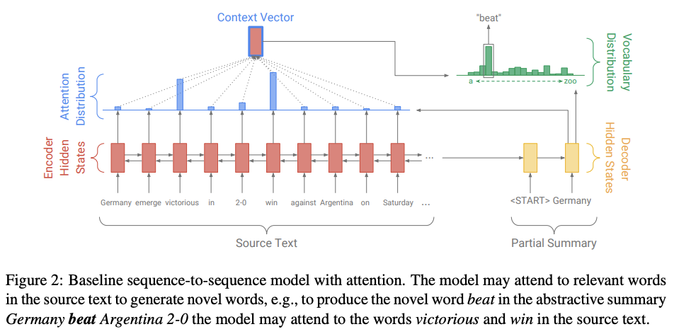
Neural summarization: abstractive + extractive [See et al., ACL 2017]
Get To The Point: Summarization with Pointer-Generator Networks, See et al, 2017, https://arxiv.org/pdf/1704.04368.pdf

Slide 24
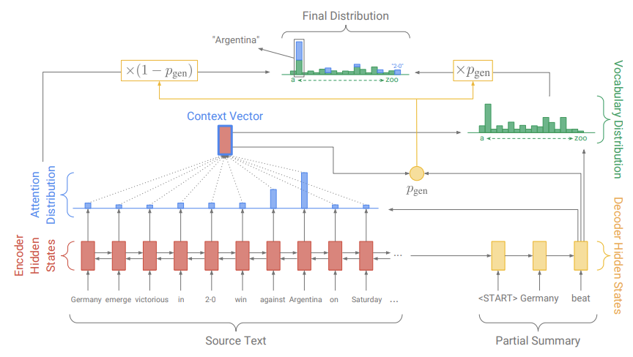
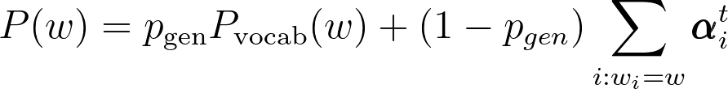
Neural summarization: abstractive + extractive
Combining “copy” and “generation”
The weight on whether to copy from source or to generate is controlled by P_{gen}
Here, the equation of the left: c_{t} is the context vector, s_{t} is the decoder state, x_{t} is the decoder input, and the a_{t} is the attention distribution. P_{gen} is in the range of [0, 1] because of the sigmoid. P_{vocab} is the usual softmax function.

Slide 25
Neural summarization: copy mechanisms
Copy mechanisms enable a seq2seq system to copy words and phrases from the input to the output
Many other copy mechanisms are proposed:
Language as a Latent Variable: Discrete Generative Models for Sentence Compression, Miao et al, 2016 https://arxiv.org/pdf/1609.07317.pdf
Abstractive Text Summarization using Sequence-to-sequence RNNs and Beyond, Nallapati et al, 2016 https://arxiv.org/pdf/1602.06023.pdf
Incorporating Copying Mechanism in Sequence-to-Sequence Learning, Gu et al, 2016 https://arxiv.org/pdf/1603.06393.pdf
Big problem with copy mechanisms
They copy too much!
Mostly long phrases, sometimes even whole sentences
What should be an abstractive system collapses to a mostly extractive system
Another problem:
They are bad at overall content selection, especially if the input document is long
No overall strategy for selecting content

Slide 26
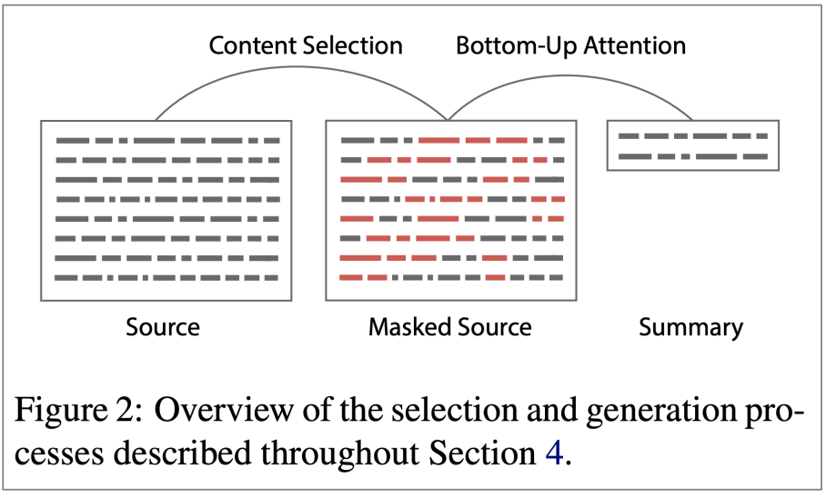
Neural summarization via content selection [Gehrmann et al., ACL 2018]
Content selection stage: Use a neural sequence-tagging model to tag words as ‘include’ or ‘don’t include’ (like POS tagging!)
Bottom-up attention stage: The seq2seq+attention system cannot attend to words tagged as ‘don’t include’ (apply a mask)
Very effective! Better global content selection. Less copying of very long sequences
Bottom-Up Abstractive Summarization, Gehrmann et al, 2018 https://arxiv.org/pdf/1808.10792v1.pdf

Slide 27
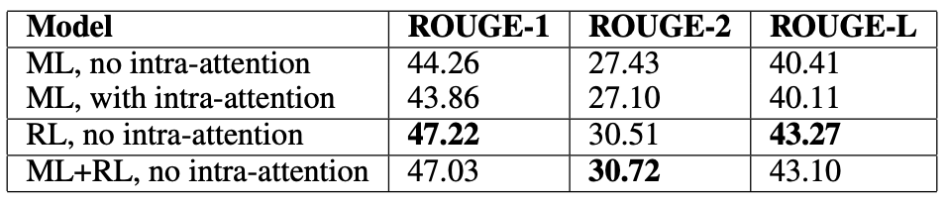
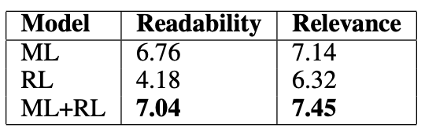
Neural summarization via Reinforcement Learning [Paulus et al., ICLR 2017]
In 2017 Paulus et al. published a “deep reinforced” summarization model
Main idea: Use Reinforcement Learning (RL) to directly optimize ROUGE-L
By contrast, standard maximum likelihood (ML) training cannot directly optimize ROUGE-L because it’s a non-differentiable function!
Interesting finding:
Using RL instead of ML achieved higher ROUGE scores, but lower human judgment scores….LoL
But hybrid approach does best!!
ROUGE scores
Human judgement
A Deep Reinforced Model for Abstractive Summarization, Paulus et al, 2017 https://arxiv.org/pdf/1705.04304.pdf

Slide 28
Generation Tasks and Approaches - Dialogue
(Read this on your own time)

Slide 29
Dialogue
“Dialogue” encompasses a large variety of settings:
Task-oriented dialogue
Assistive (e.g., customer service, giving recommendations, question answering, help user accomplish a task like buying or booking)
Co-operative (two agents solve a task together through dialogue)
Adversarial (two agents compete in a task through dialogue)
Social dialogue
Chit-chat (for fun or company)
Therapy

Slide 30
Pre- and post-neural dialogue
Due to the difficulty of open-ended freeform NLG, pre-neural dialogue systems often used predefined templates, or retrieve an appropriate response from a corpus of responses
As in summarization research, sine 2015, there have been many papers applying seq2seq methods to dialogue - thus leading to a renewed interest in open-ended freeform dialogue systems
Some early seq2seq dialogue papers include:
A Neural Conversational Model, Vinyals et al, 2015 https://arxiv.org/pdf/1506.05869.pdf
Neural Responding Machine for Short-Text Conversation, Shang et al, 2015 https://www.aclweb.org/anthology/P15-1152
This is a nice overview of recent (mostly neural) conversational conversational AI work: https://medium.com/gobeyond-ai/a-reading-list-and-mini-survey-of-conversational-ai-32fceea97180

Slide 31
Seq2seq-based dialogue
However, it quickly became apparent that a naive application of standard seq2seq+attention methods has serious pervasive deficiencies for (chitchat) dialogue:
Genericness / boring responses
Irrelevant responses (not sufficiently related to context)
Repetition
Lack of context (not remembering conversation history)
Lack of consistent persona

Slide 32
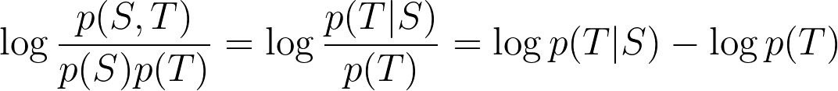
Seq2seq-based dialogue - irrelevant response problem
Problem: seq2seq often generates response that’s unrelated to user’s utterance
Either because it’s generic (e.g., “I don’t know”)
Or changing the subject to something unrelated
Solution: optimize for Maximum Mutual Information (MMI) between input S and response T:
This p(T) is saying don’t output too “generic” stuffs
usual
added
A Diversity-Promoting Objective Function for Neural Conversation Models, Li et al, 2016 https://arxiv.org/pdf/1510.03055.pdf

Slide 33
Seq2seq-based dialogue - boring response problem
Easy test-time fixes
Directly upweight rare words during beam search
Use a sampling decoding algorithm rather than beam search
Conditioning fixes
Condition the decoder on some additional content (e.g., sample some content words and attend to them)
Train a retrieve-and-refine model rather than a generate-from-scratch model
i.e., sample an utterance from your corpus of human-written utterances, and edit it to fit the current scenario
Why are Sequence-to-Sequence Models So Dull?, Jiang et al, 2018 https://staff.fnwi.uva.nl/m.derijke/wp-content/papercite-data/pdf/jiang-why-2018.pdf

Slide 34
Seq2seq-based dialogue - repetition problem
Simple solution:
Directly block repeating n-grams during beam search
Works well!
More complex solutions:
Train a coverage mechanism - in seq2seq, this is an objective that prevents the attention mechanism from attending to the same words multiple times
Define a training objective to discourage repetition
If this is a non-differentiable function of the generated output, then will need some technique like e.g., RL to train

Slide 35
Seq2seq-based dialogue - lack of consistent persona problem
In 2016, Li et al proposed a seq2seq dialogue model that learns to encode both conversation partners’ personas as embeddings
The generated utterances are conditioned on the embeddings
There is now a chit-chat dataset called PersonaChat, which includes personas (collections of 5 sentences describing personal traits) for every conversation
Allow researchers to build persona-conditional dialogue agents
A Persona-Based Neural Conversation Model, Li et al 2016, https://arxiv.org/pdf/1603.06155.pdf
Personalizing Dialogue Agents: I have a dog, do you have pets too?, Zhang et al, 2018 https://arxiv.org/pdf/1801.07243.pdf

Slide 36
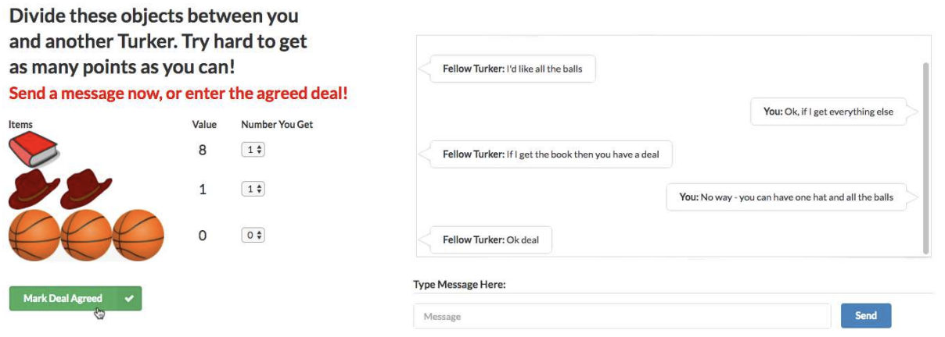
Negotiation dialogue
In 2017, Lewis et al. collected a negotiation dialogue dataset
Two agents negotiate (via natural language) how to divide a set of items
The agents have different value functions for the items
The The agents talk until they reach an agreement
Deal or No Deal? End-to-End Learning for Negotiation Dialogues, Lewis et al, 2017 https://arxiv.org/pdf/1706.05125.pdf

Slide 37
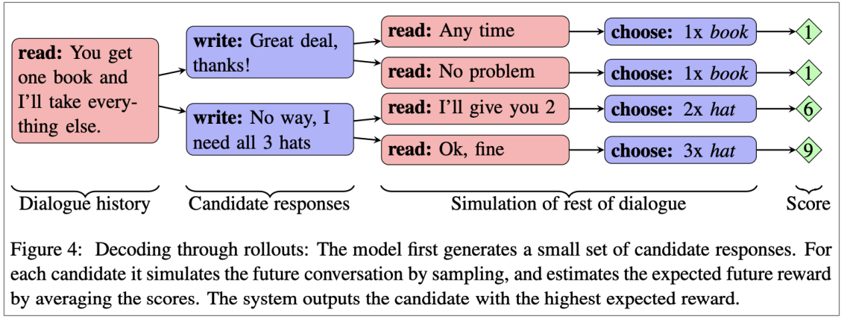
Negotiation dialogue
They find that training seq2seq systems for the standard maximum likelihood (ML) objective yields fluent but strategically poor dialogue agents
They also use Reinforcement Learning to optimize for a discrete reward (with the agents playing against themselves during training)
Potential problem: if the agents just optimize just the RL goal while playing against each other, they might diverge from English!
*This observation led to an unfortunate media over-reaction: https://www.skynettoday.com/briefs/facebook-chatbot-language/
Deal or No Deal? End-to-End Learning for Negotiation Dialogues, Lewis et al, 2017 https://arxiv.org/pdf/1706.05125.pdf

Slide 38
Negotiation dialogue
In 2018, Yarats et al proposed another dialogue model for the negotiation task, that separates the strategic aspect from the NLG aspect.
This separation was standard in “old” discourse/dialog NLG approaches
Each utterance x_{t} has a corresponding discrete latent variable z_{t}
z_{t} is learned to be a good predictor of future events in the dialogue (future messages, ultimate strategic outcome), but not a predictor of x_{t} itself
This means that “z_{t} learns to represent x_{t}’s effect on the dialogue, but not the words of x_{t} ”
This approach seems useful for controllability, interpretability, easier to learn strategy, etc.
Hierarchical Text Generation and Planning for Strategic Dialogue, Yarats et al, 2018 https://arxiv.org/pdf/1712.05846.pdf

Slide 39
Generation Tasks and Approaches - Storytelling
(Read this on your own time)

Slide 40
Storytelling
Most neural storytelling work uses some kind of prompt
Generate a story-like paragraph given an image
Generate a story given a brief writing prompt
Generate the next sentence of a story, given the story so far (story continuation)
This is different to the previous two, because we are not concerned with the system’s performance over several generated sentences
Neural storytelling is taking off!
The first workshop in 2018
It held a competition! (generate a story to accompany a sequence of 5 images)
Storytelling Workshop 2019: http://www.visionandlanguage.net/workshop2019/

Slide 41
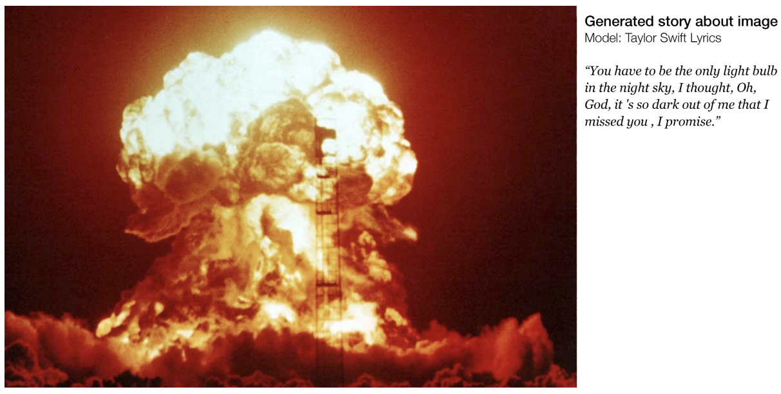
Storytelling
This isn’t straightforward as supervised image-captioning. There was no paired data to learn from!
Generating Stories about Images, https://medium.com/@samim/generating-stories-about-images-d163ba41e4ed

Slide 42
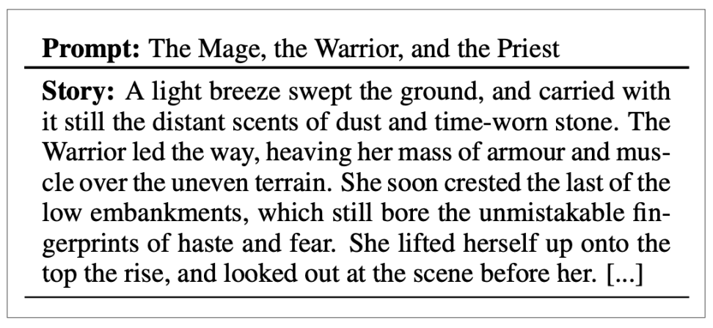
Storytelling
In 2018, Fan et al. released a new story generation dataset collected from Reddit’s WritingPrompts subreddit
Each story has an associated brief writing prompt
Hierarchical Neural Story Generation, Fan et al, 2018 https://arxiv.org/pdf/1805.04833.pdf

Slide 43
Storytelling
Fan et al. also proposed a complex seq2seq prompt-to-story model:
It’s convolutional-based
This makes it faster than RNN-based seq2seq
Gated multi-head multi-scale self-attention
The self attention is important for capturing long-range context
The gates allow the attention mechanism to be more selective
The different attention heads attend at different scales - this means there are different attention mechanisms dedicated to retrieving fine-grained information and coarse-grained information
Model fusion
Pretrain one seq2seq model, then train a second seq2seq model that has access to the hidden states of the first
The idea is that the first seq2seq learns general LM and the second learns to condition on the prompt
Hierarchical Neural Story Generation, Fan et al, 2018 https://arxiv.org/pdf/1805.04833.pdf

Slide 44
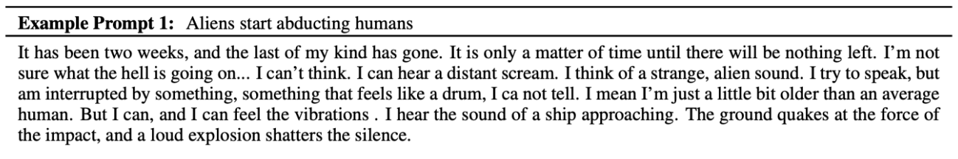
Storytelling
The results are impressive!
Related to prompt
Diverse; non-generic
Stylistically dramatic
However, mostly atmospheric/descriptive/scene-setting; less events/plot
When generating for longer, mostly stays on the same idea, without moving forward to new ideas - coherence issues
Hierarchical Neural Story Generation, Fan et al, 2018 https://arxiv.org/pdf/1805.04833.pdf

Slide 45
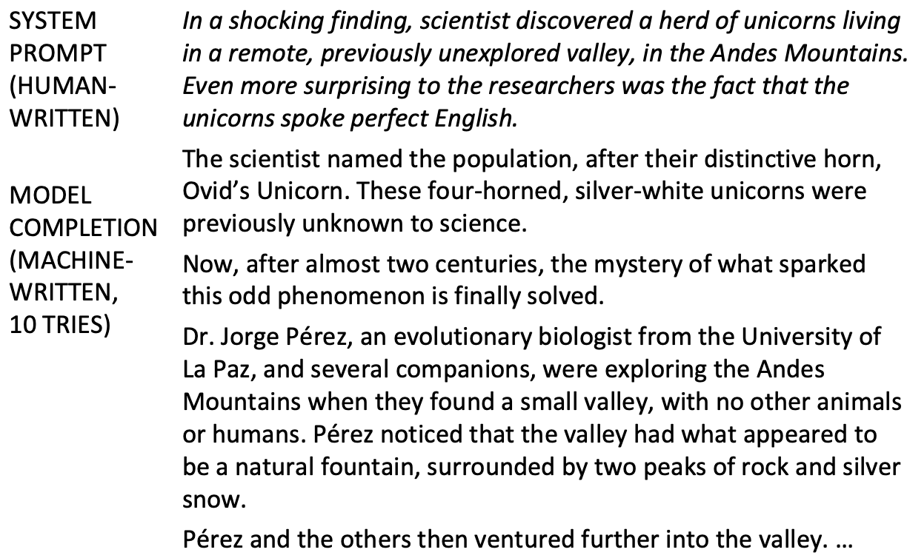
Storytelling - GPT2 - transformer-based - even better :-)

Slide 46
Storytelling - challenges
Stories generated by neural LMs can sound fluent...but are meandering, nonsensical, with no coherent plot. What’s missing?
LMs model sequence of words. Stories are sequence of events. To tell a story, it’s lot more complicated!
Events and the causality between events (Martin et al. 2018)
Characters, personalities, motivations, relationships
State of the world (who, what, where, why) (Yejin Choi research group)
Narrative structure (e.g., exposition -> conflict -> resolution) (Fan et al. 2019)
Good storytelling principles (don’t introduce a story element then never use it)
Event Representations for Automated Story Generation with Deep Neural Nets, Martin et al, 2018 https://www.aaai.org/ocs/index.php/AAAI/AAAI18/paper/view/17046/15769
Yejin Choi research group: https://homes.cs.washington.edu/~yejin/
Strategies for Structuring Story Generation, Fan et al, 2019 https://arxiv.org/pdf/1902.01109.pdf

Slide 47
Evaluation

Slide 48
BLEU [Papineni et al., ACL 2002]
BLEU (Bilingual Evaluation Study)
BLEU compares the machine-written translation to one or several human-written translation(s), and computes a similarity score based on:
n-gram precision (usually for 1, 2, 3 and 4-grams)
Plus a penalty for too-short system translations
BLEU is useful but imperfect
There are MANY valid ways to translate a sentence
So a good translation can get a poor BLEU score because it has low n-gram overlap with the human translation
BLEU: a Method for Automatic Evaluation of Machine Translation, Papineni et al, 2002. http://aclweb.org/anthology/P02-1040

Slide 49
ROUGE [Lin, ACL 2004]
ROUGE (Recall Oriented Understudy for Gisting Evaluation)
ROUGE not ROGUE (from star wars!)
Like BLEU, it’s based on n-gram overlap.
Differences:
Bleu measures precision: how much the words (and/or n-grams) in the machine generated summaries appeared in the human reference summaries.
Rouge measures recall: how much the words (and/or n-grams) in the human reference summaries appeared in the machine generated summaries.
Rouge also has a version for precision, but the difference for BLEU is that it has brevity penalty
It’s also very normal to combine them: F1 = 2 * (Bleu * Rouge) / (Bleu + Rouge)
ROUGE: A Package for Automatic Evaluation of Summaries, Lin, 2004 http://www.aclweb.org/anthology/W04-1013

Slide 50
ROUGE vs. BLEU
BLEU is reported as a single number, which is combination of the precision for n=1, 2, 3, 4 n-grams
ROUGE scores are reported separately for each n-gram
The most commonly-reported ROUGE scores are:
ROUGE-1: unigram overlap
ROUGE-2: bigram overlap
ROUGE-L: longest common subsequence overlap
A python implementation of ROUGE
https://github.com/pltrdy/rouge

Slide 51
Automatic evaluation metrics for NLG
Word overlap based metrics (BLEU, ROUGE, METEOR, F1, etc.)
We know that they’re not ideal for machine translation
They’re much worse for summarization, which is more open ended than machine translation
Unfortunately, ROUGE also typically rewards extractive summarization systems more than abstractive systems
And they’re much, much worse for dialogue, which is even more open-ended than summarization.
Similarly for, e.g., story generation, poetry…..(you don’t want to imagine…)

Slide 52
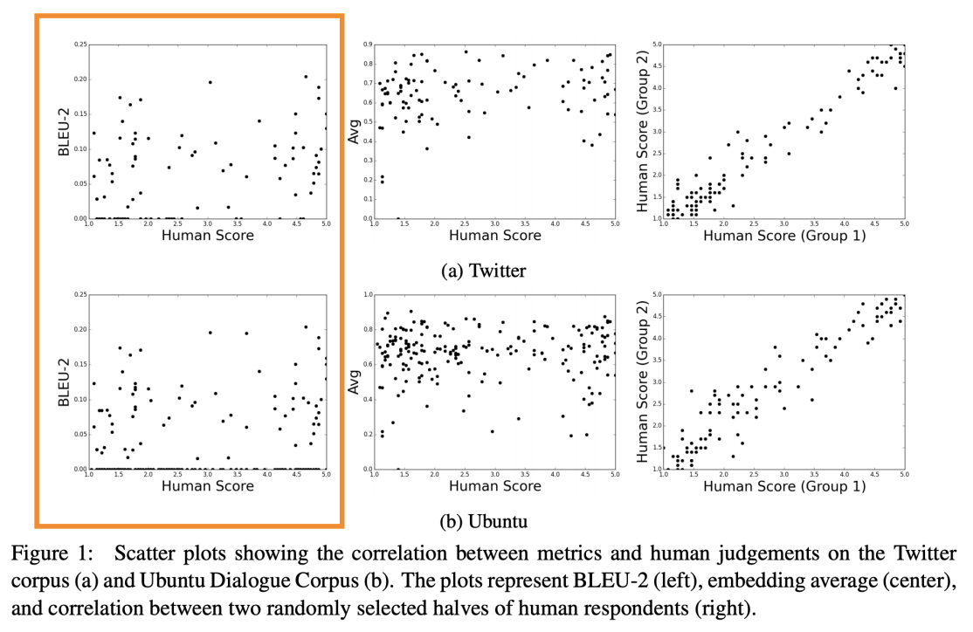
Word overlap metrics are not good for dialogue [Liu et al., ACL 2017]
How NOT To Evaluate Your Dialogue System: An Empirical Study of Unsupervised Evaluation Metrics for Dialogue Response Generation, Liu et al, 2017 https://arxiv.org/pdf/1603.08023.pdf

Slide 53
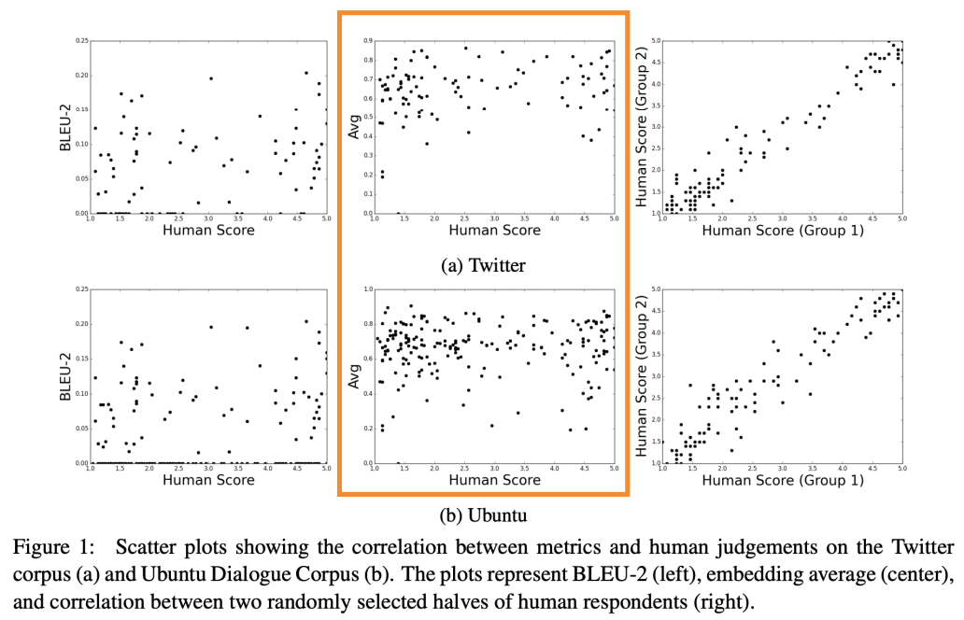
Word embedding metrics are not good either [Liu et al., ACL 2017]
How NOT To Evaluate Your Dialogue System: An Empirical Study of Unsupervised Evaluation Metrics for Dialogue Response Generation, Liu et al, 2017 https://arxiv.org/pdf/1603.08023.pdf

Slide 54
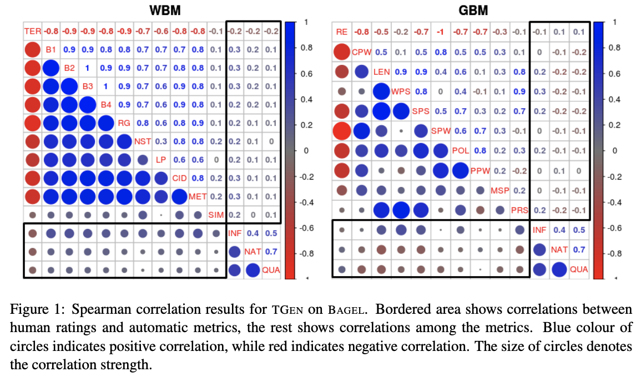
Other existing metrics are not good either for dialogue [Novikova et al., ACL 2017]
WBM: Word-based Metrics
GBM: Grammar-based metrics
Why We Need New Evaluation Metrics for NLG, Novikova et al, 2017 https://arxiv.org/pdf/1707.06875.pdf

Slide 55
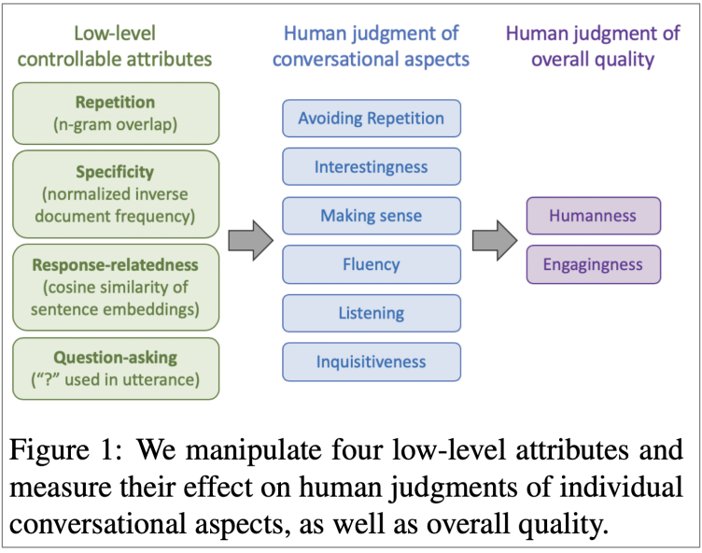
Humans are inconsistent! [See et al., NAACL 2019]
What if we got access to thousands of humans?
Conducting human evaluation is very difficult!
Inconsistent
Illogical
Lose concentration
Misinterpret your question
Can’t always explain why they feel the way they do
Solution: detailed human evaluation system that separates out important factors that contribute to overall quality, but still very difficult according to See et al. 2019!
What makes a good conversation? How controllable attributes affect human judgments, See et al, 2019 https://arxiv.org/pdf/1902.08654.pdf

Slide 56
Automatic evaluation metrics for NLG
Thus, bad news….no automatic metrics to adequately capture overall quality
But we can define more focused automatic metrics to capture particular aspects of generated text:
Fluency (compute probability w.r.t. Well-trained LM)
Correct style (prob w.r.t LM trained on target corpus)
Diversity (rare word usage, uniqueness of n-grams)
Relevance to input (semantic similarity measures)
Simple things like length and repetition
Task-specific metrics, e.g., compression rate for summarization

Slide 57
Possible new ways for NLG eval?
Corpus-level metrics
Should an eval metric be applied to each example in the test set independently, or a function of the whole corpus?
e.g. if a dialogue model always gives the same generic answer to every example in the test set, it should be penalized
Eval metrics that measure the diversity-safety tradeoff
Human eval for free
Gamification: make the task (e.g. talking to a chatbot) fun, so humans provide supervision and implicit evaluation for free
Adversarial discriminator as an evaluation metric
Test whether the NLG system can fool a discriminator which is trained to distinguish human text from artificially generated text

Slide 58
Summary
Natural language generation has MUCH to do!
Bottleneck on generating natural responses
Changing the loss function is worthwhile direction to try to optimize for certain properties
When it’s not possible (not differentiable), use RL
Alternative to maximum likelihood training with teacher forcing
The lack of effective metrics that are highly correlated to human judgments (this is the biggest bottleneck in this area!)
Among them...storytelling is probably the hardest! Don’t even want to think about poetry (which I have not covered…).
Even storytelling seems trivial, the problem about modeling the world, narratives, emotions can be enlightening to other deep learning problems…..who knows?

